Slide 1
Drive communications
Email Ping Pong

Slide 2


Team
Artem Petrenko - 6 years in IT
Positions: Business Development Manager, Sales, Account Manager, Project management
Ewgeny Maksak - 8 years in IT
Positions: Software Architect, Team Lead, .NET senior developer

Slide 3
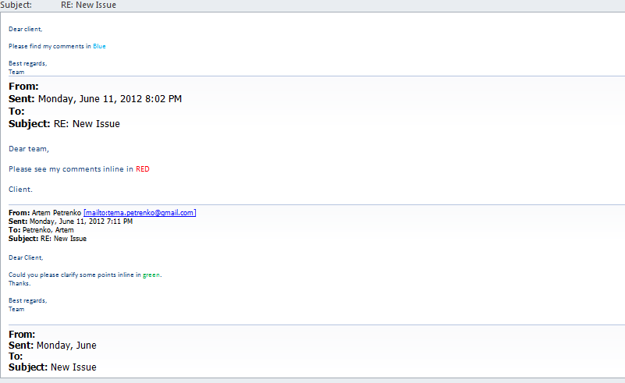
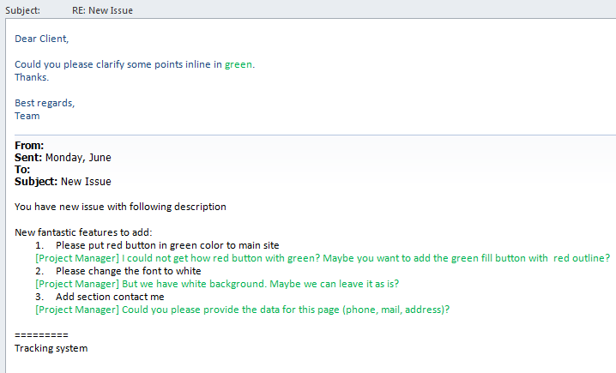
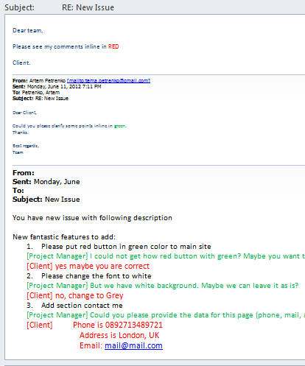

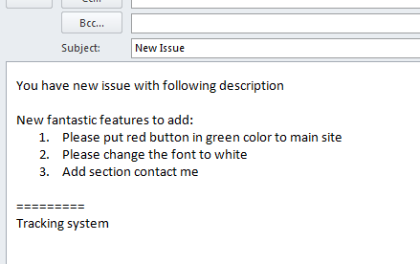
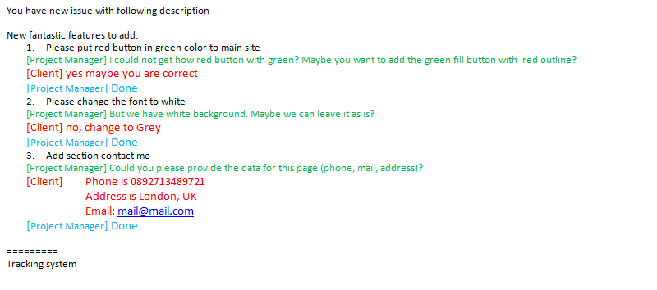


How it looks now: Process
OPEN
Product
Owner
Manager
Closed
Tracking
system

Slide 4
How it looks now: Summary
Benefits
Problems
Flexible
Fast
Habit
Easy to use
Not structured content
Mess in conversations
Stored at mail server
Hard to match the issues with the responses

Slide 5
How it could look like
During Email Ping Pong you need to do:
Open
Select text
Mark as Question or Answer
Send
All info stored in the local Database and could be synchronized with issue tracking systems (e.g. JIRA, TFS, Basecamp, etc.)

Slide 6
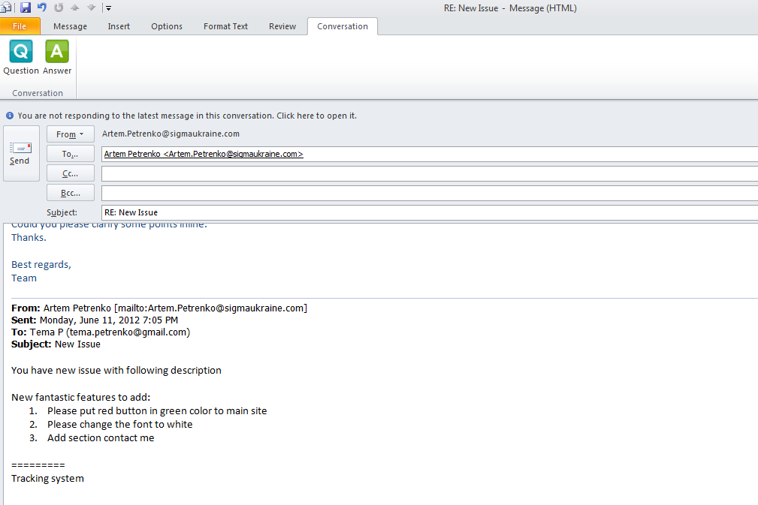
Email with initial text
Select text

Slide 7
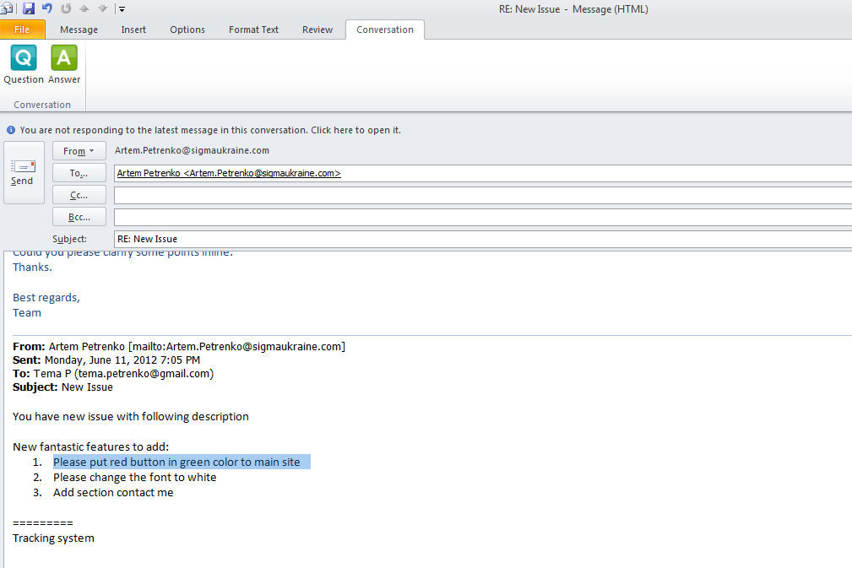
Click Question
Select text

Slide 8
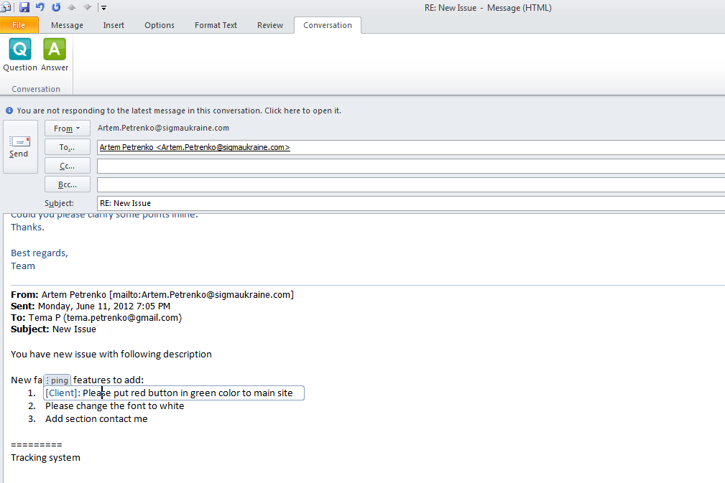
Text is marked with
Question tag

Slide 9
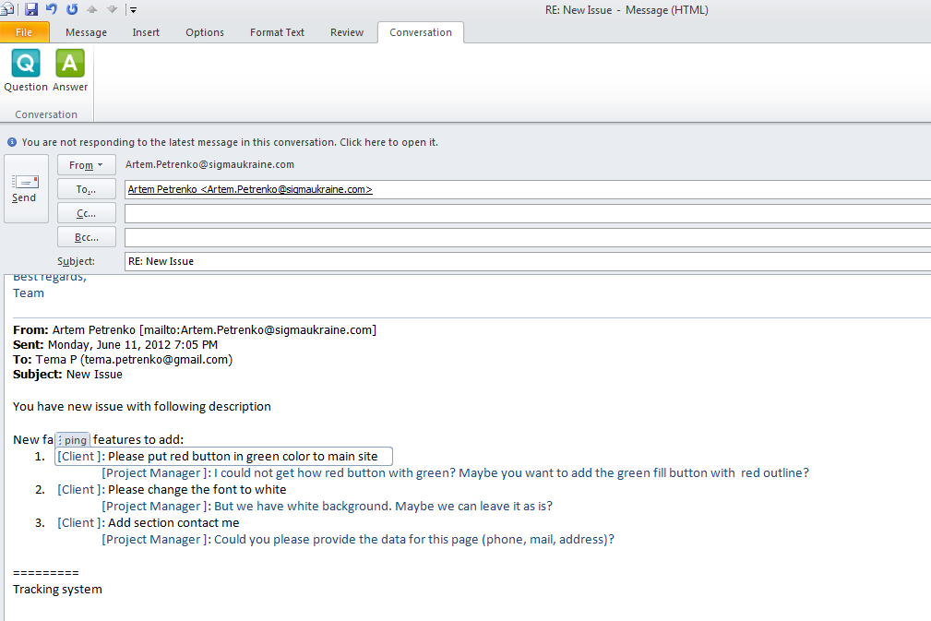
1.Click the button Answer
2.Type your comment
3. Send

Slide 10
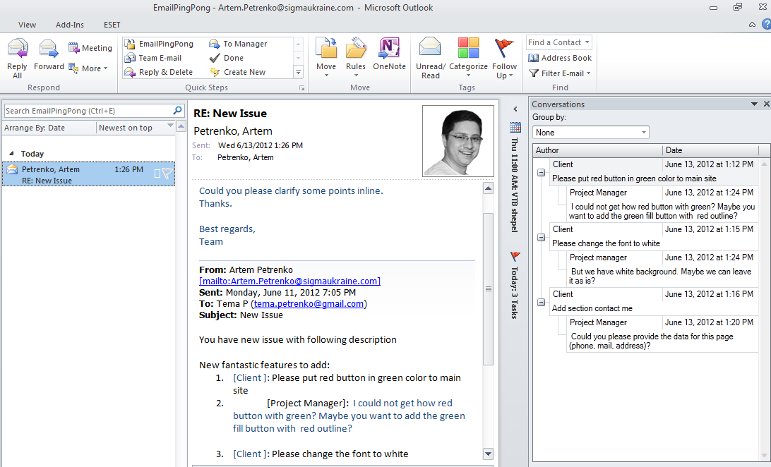
Email with structured
content

Slide 11
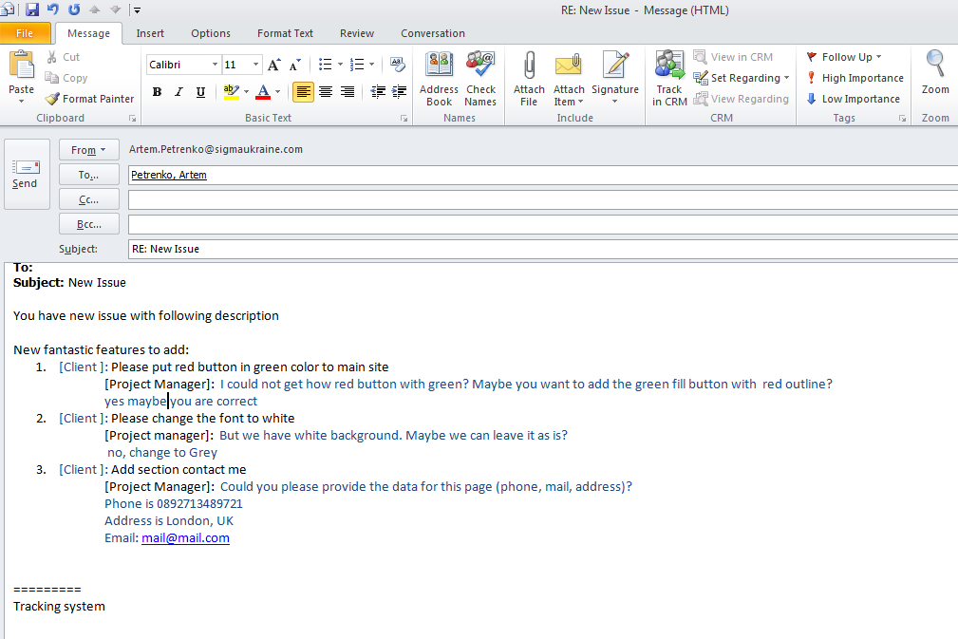
Get the answer
in plain text

Slide 12
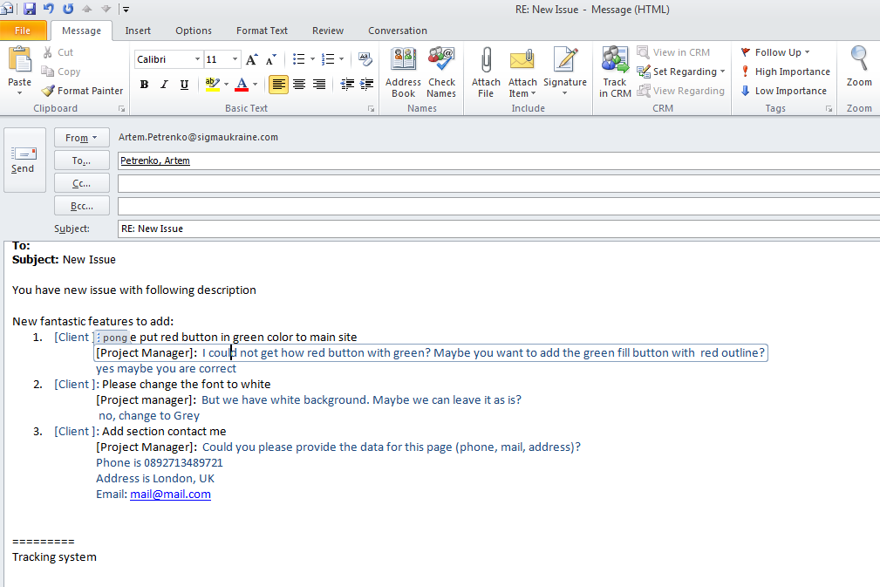
Get the answer
in plain text

Slide 13
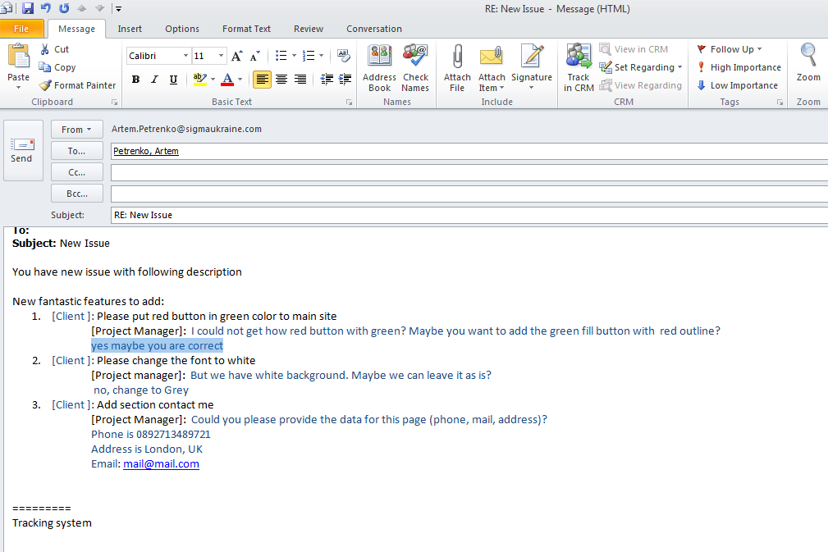
Select text

Slide 14
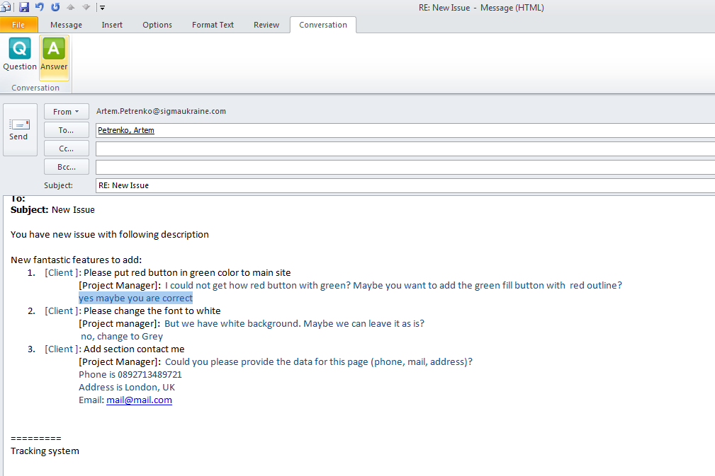
Click the Answer

Slide 15
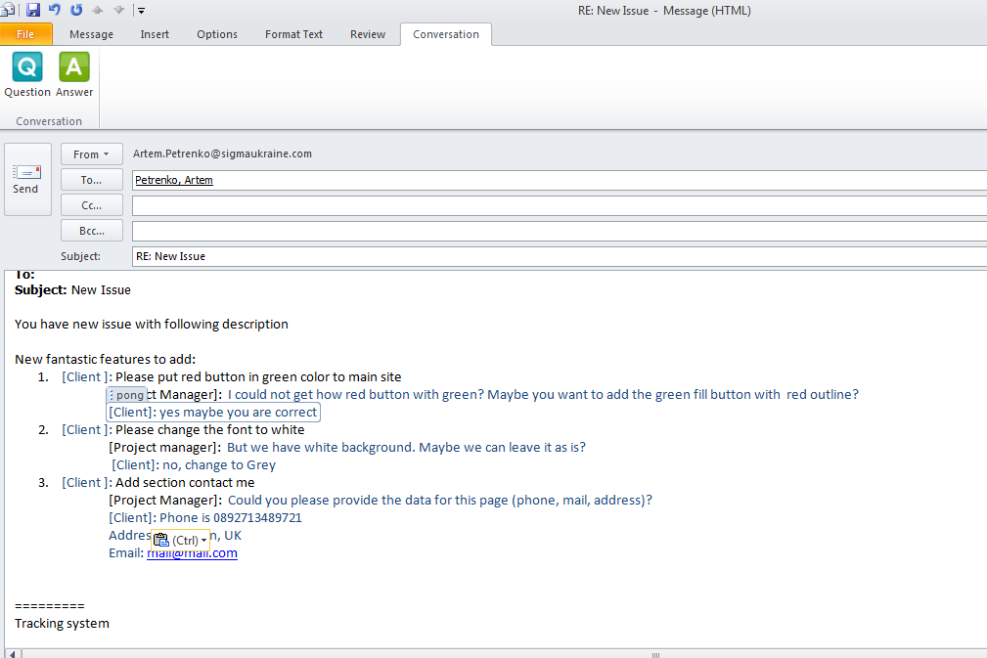
Text is marked
with Answer tag

Slide 16
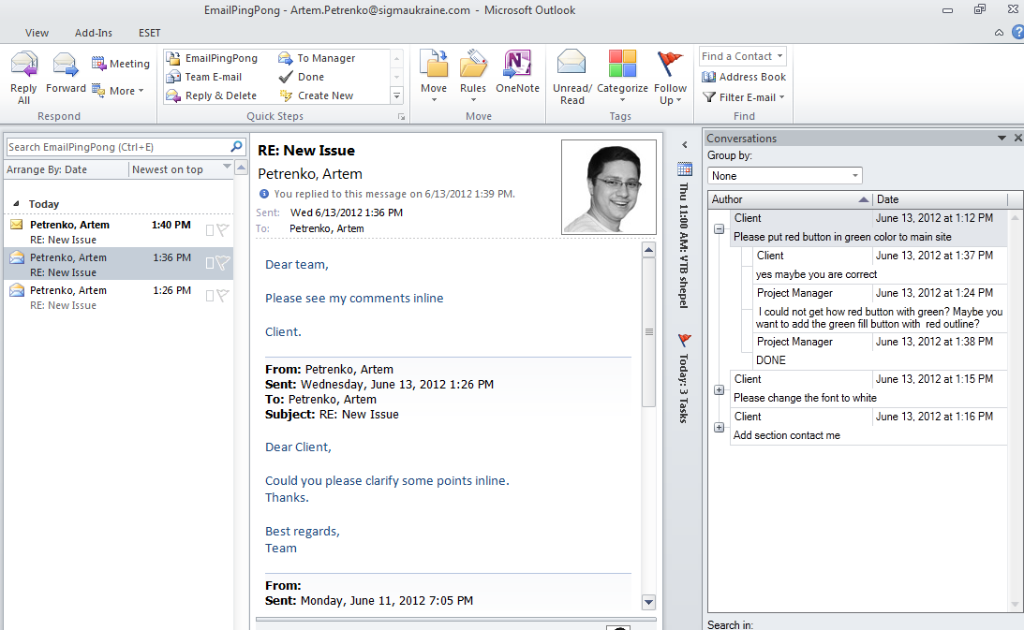
Database is updated
with latest content

Slide 17
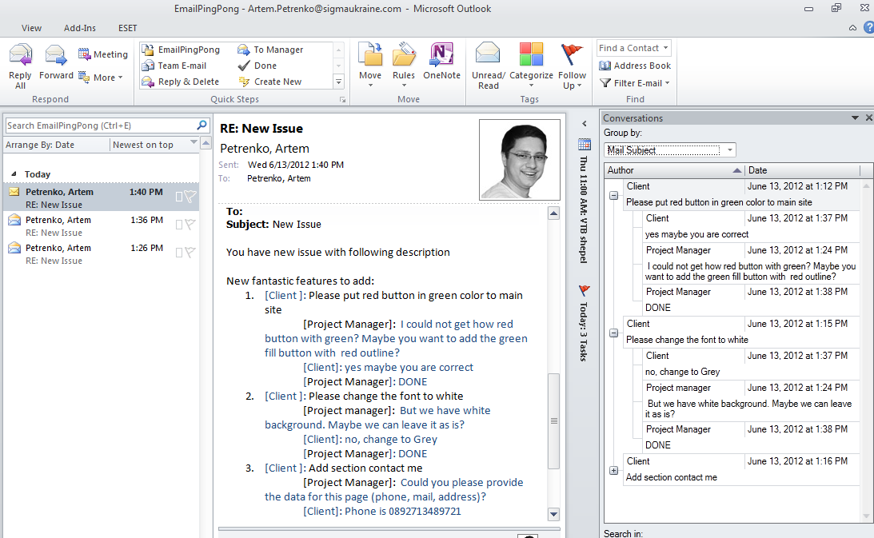

Slide 18
Email Ping Pong
Track a content
Link with issue in tracking systems
Keep history of changes
Setup reminders if no feedback
Group content by Issues, Projects, Accounts etc.

Slide 19
Contacts
Email: tema.petrenko@gmail.com
Phone: +380506519604
Skype: artem_petrenko

